Slide 1
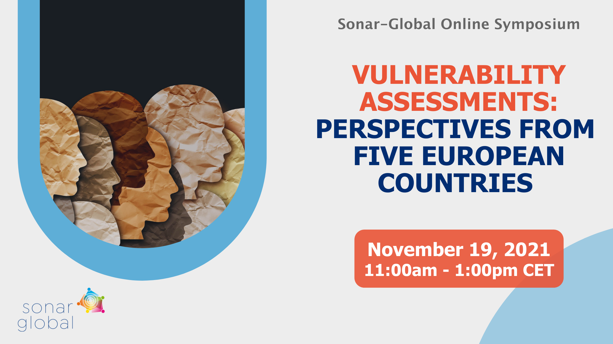

Slide 2
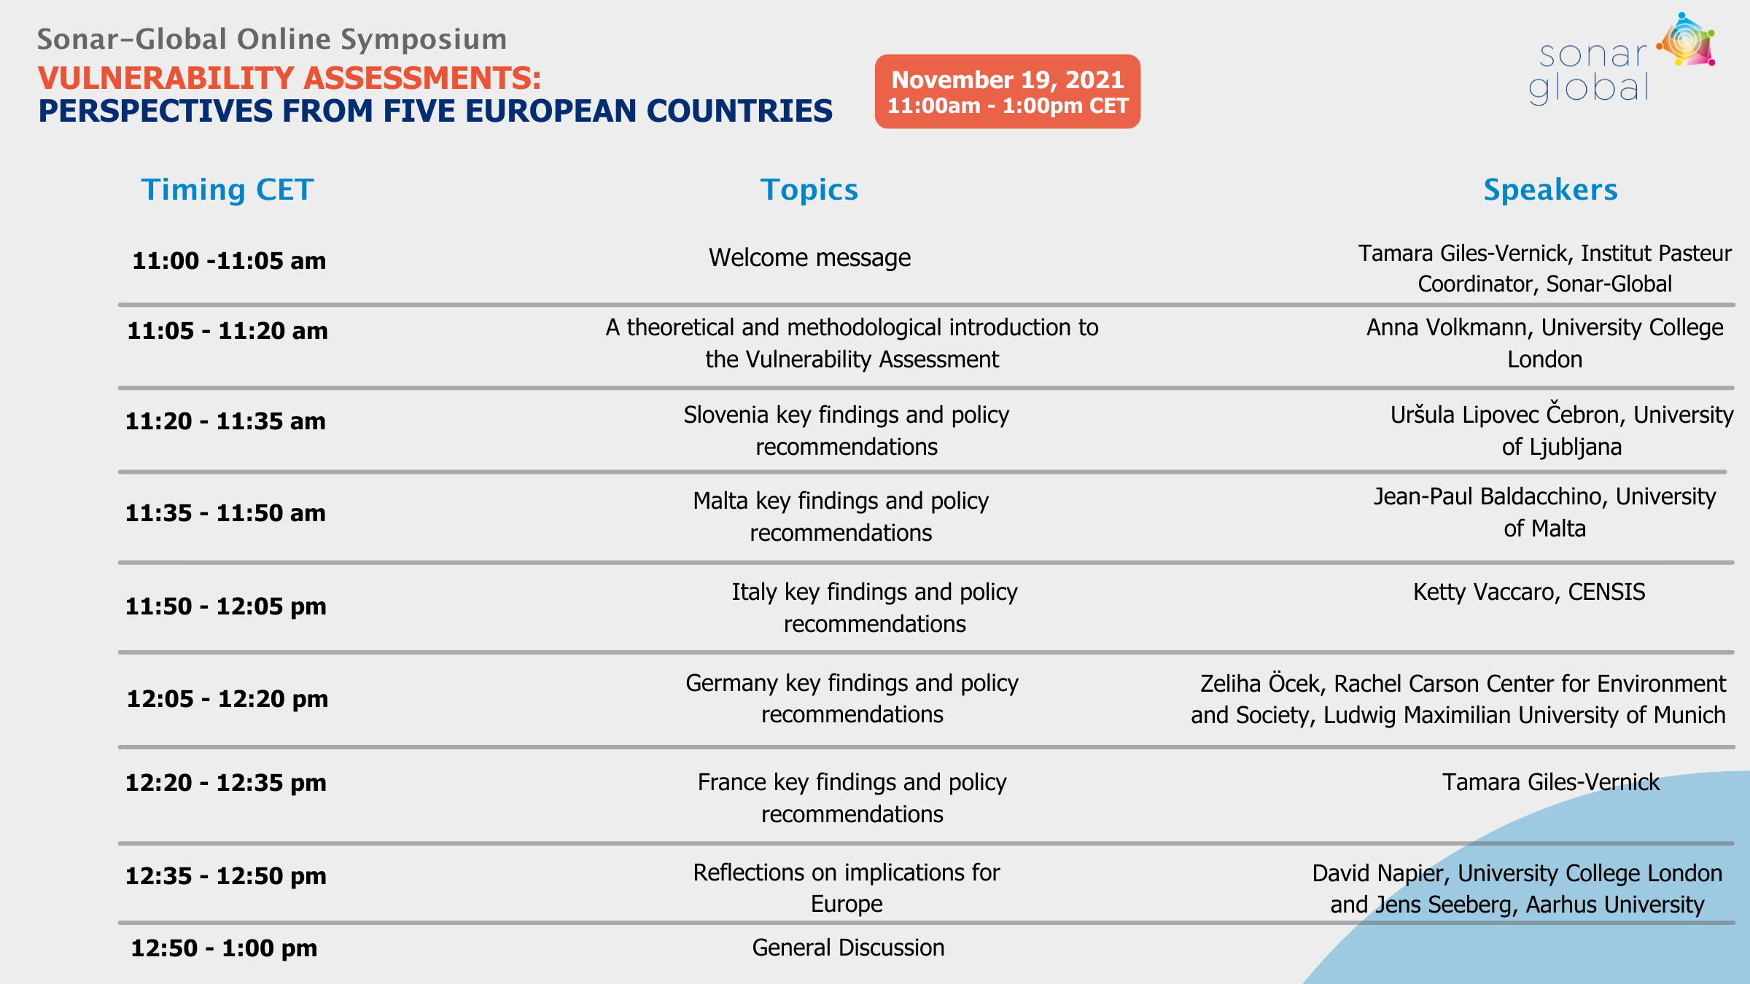

Slide 3

Vulnerability Assessments
Anna-Maria Volkmann
University College London
a.volkmann@ucl.ac.uk

Slide 4
Definitions of Vulnerability
First things first!
What do we mean when we speak of vulnerability?
  The term can be an ill-defined ‘black box’
  Different people, different meanings:
    Biological/ physiological vulnerability (e.g., risk factors for diabetes)
    Emotional/ psychological vulnerability (e.g., young age, mental health impairments, etc.)
    Socio-economic vulnerability (e.g., isolated/ socially and/ or financially disadvantaged)
    Cultural vulnerability (e.g., non-’normative’ habits or customs)
  + Linguistics!

Slide 5
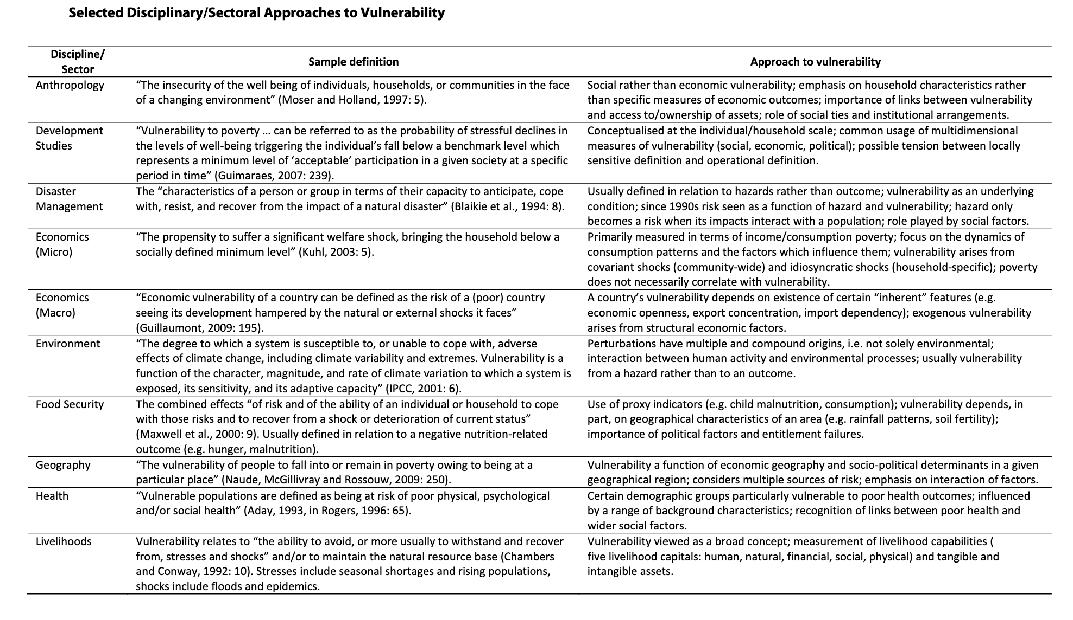
Concepts of Vulnerability
1) Sumner, Andy; Mallett, Rich (2011)

Slide 6
Concepts of Vulnerability
The emergence of the concept of vulnerability has been linked to the “purely hazard-oriented perception of disaster risk in the 1970s”.¹
The study of vulnerability was generally dominated by “technical interventions focused on predicting hazards or modifying their impact”.¹
1) Birkmann (2006), 2) Hilhorst and Bankoff (2004)

Slide 7
Concepts of Vulnerability:
What can we agree on?
1) “Risk” is at the heart of the concept of vulnerability
2) Vulnerability is not absolute, but a matter of degrees
3) Vulnerability is cumulative over the life course
4) The concept of vulnerability may be used similarly to notions of need, susceptibility to harm or neglect, or lacking durability or capability.
The World Health Organisation, along those lines, speaks of vulnerable groups as
    Children, pregnant women, elderly people, malnourished people, and people who are ill or immunocompromised, are particularly vulnerable when a disaster strikes, and take a relatively high share of the disease burden associated with emergencies.
Notes:
1) “Risk” is at the heart of the concept of vulnerability:
For example. how systems, communities and individuals react to and deal with risk
2) Vulnerability is not absolute, but a matter of degrees:
Degrees of vulnerability are produced through the interaction between external events and the coping capacity of affected individuals, households, or communities.
3) Resilience and vulnerability do not represent opposite ends of the spectrum:
They form part of the same equation: resilience determines in large part how people or systems can respond to changes in circumstances
4) Vulnerability is cumulative over the life course:
Early-life difficulties and their adverse effects interact with later events in ways that increase the likelihood of poor adult health outcomes.

Slide 8

Health Vulnerability
Inherent danger of turning vulnerability into a core concept is to picture someone as a purely passive person in need -> and the provider (however defined) as someone able to offer all the assistance needed.
However:
  Needs are complex
  As are sources and drivers of resilience
  Providers of assistance and support can take on unexpected forms (e.g. community-based)
  Remember: HEALTH IS LARGELY CREATED OUTSIDE THE HEALTH SECTOR
-
8,766 hours in a year
24 X 365.25
6 hours a year
in a doctor’s office or with other health professional¹
8,760 hours
“on your own”

Slide 9
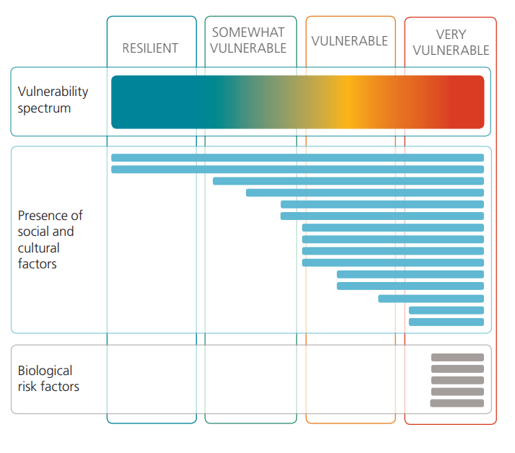
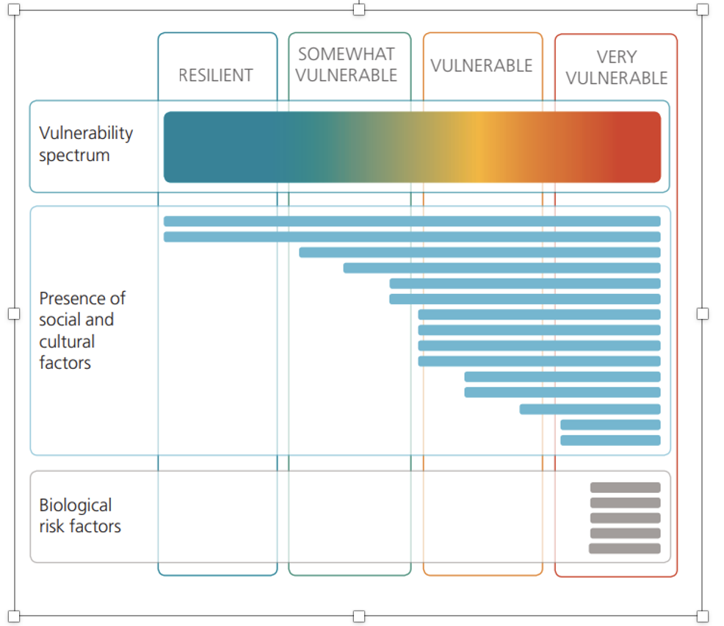
Health Vulnerability Assessments:
Definitions of Vulnerability
Because health is largely situated outside of the health care sector, a plethora of factors impact how health vulnerabilities are created, amplified, or reduced.
->
Vulnerability can be conceptualised as occurring on a spectrum.

Slide 10
(Working) Definition of Health Vulnerability
Our definition of vulnerability:
being in a situation (over a meaningful period of time) in which a distinct set of cultural, social, and biological risk factors come together to make it more likely than not that a person experiences ill health.
How then do we identify those distinct factors, while also understanding their compounding effect, and take into account resilience and existing coping strategies?

Slide 11
Health Vulnerability Assessments:
Background
Key Requirement for method: Elevate lived experience to the level of evidence.
Qualitative components
  Establish baseline, identify ‘unknowns’, capture data that can be well communicated
Rapid assessment method
  Contemporaneous analysis if possible, rapid and targeted action, especially in emergency scenarios
Iterative
  Insights gained in various stages of data collection inform next steps (‘known and unknown unknowns’)
Scalable
Replicable and transparent
‘Actionable’
Notes:
DAVID

Slide 12
Practical Aspects of Implementing a VA:
“Global” and “Local” Aims and Objectives
The aims of VAs are to:
identify local factors that reduce or augment health vulnerabilities (cross-site comparison)
develop case definitions of vulnerability and resilience (based on local case definitions)
extrapolate from participant cohort to wider population (scaling up – locally and globally)
suggest locally meaningful actions and interventions (if applicable, via stakeholder/ community involvement).
Important:
local needs and priorities are to be taken into account.
The global protocol is adapted to local conditions, collaboration with stakeholders – connecting VA and CE components

Slide 13
Practical Aspects of Implementing a VA:
Research Sites and Study Participant Selection
VAs are implemented initially in a pre-defined cohort based on local priorities, knowledge base, and needs, but:
  a proportion of participants are recruited through snowball-sampling based on reported vulnerability/ resilience by other participants.
  Thus, participant recruitment is iterative and adjustments to the initial interview protocol during the course of the study may also occur.
  Stakeholder engagement here is important.
    Start by pre-defining well-established/ likely characteristics linked to vulnerability.
    Select percentage of cohort based on those characteristics.
    Adjust throughout data collection period of needed.
Research sites are chosen to contrast between some participant characteristics and based on local knowledge/ prior research.

Slide 14
Vulnerability Assessments in multi-site studies:
Data Collection “Global” Structure
(Overall Assessment)
Demographic Survey Questions
Interview Protocol
(Field Administered)
Vulnerability Domain
Formal Domain
Community Domain
Ethnographic Observations
Notes:
DAVID

Slide 15
Vulnerability Assessments in multi-site studies:
Data Analysis and Outcomes
Interview Transcripts
Coded and analysed (data reduction (TCA)
Main Themes
Further analysis
Local Vulnerability Factors
Complex Case Definitions of Vulnerability
'mapped' onto existing epi. data
Synthesis of findings
Nuanced and informative findings to inform action locally
Notes:
DAVID

Slide 16
Vulnerability Assessment in Slovenia
assoc. prof. dr. Uršula Lipovec Čebron
Department of Ethnology and Cultural Anthropology
University of Ljubljana, Faculty of Arts

Slide 17
Some Covid-19 related events in Slovenia
3. March 2020 | First Covid-19 case confirmed in Slovenia
12. March 2020 | Epidemic is declared.
13. March 2020 | New government takes power – new prime-minister is Janez Janša.
 | The heads of the main institutions are replaced - including those involved in epidemic management.
28. February (ongoing) | A series of anti-governent protests – in various forms, as the decree prohibits gathering in public areas
All confirmed cases (on November 18th 2021): 391.677; died: 5001
Nov 7th 2021: Slovenia has the most daily new confirmed cases per million inhabitants in the world

Slide 18
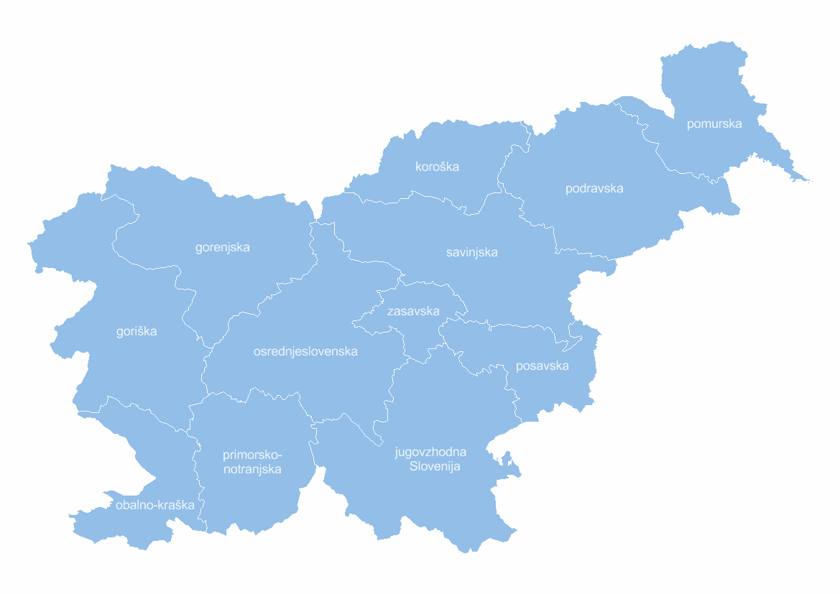
Research locations
Ljubljana – the capital
  (pop. 290.000 + daily work migration)
  econonomic, educational, political and
  administrative centre of the country,
  high living costs
Murska Sobota with surrounding area
  (pop. ≈19.000)
  socially and economically disadvantaged area,
  border region, bilingual territory,
  poor transport links, large Roma communities
MS
LJ
Notes:
LJ:Its permanent population represents 14% of the country+large student population (usually), daily migration for work
-centralisation of institutions, more financial support, more media coverage, gentrified, high rent, high living costs, largest centre for asylum seekers in the country
MS: underprivileged area, remote, less developed and less opportunities, poor transport links, lower average income, significant Roma population, Hungarian ethnic minority, distinctive dialect, left behind in development, more people work in agriculture

Slide 19
Participants:
214 vulnerability assessments conducted

Slide 20
Participant vulnerabilities
elderly living alone
entrepreneurs in service sector, self-employed, live entertainment industry, workers in tourism - atypical employment arrangements
unemployed
homeless
youth
people with chronic illnesses
women with various vulnerabilities
students
migrants/refugees/undocumented people
users in open drug scene
sex workers
healthcare workers, teachers - especially exposed professionals
(single) parents
people with mental health issues
the Roma
victims of domestic violence
farmers
daily migrants working abroad

Slide 21
1. Intersections of vulnerabilities not able to interpret as vulnerable groups, but as intertwining of „bubbles“ of vulnerabilies:
victim of domestic violence
Policy recommendation: move beyond the concept of vulnerability group – policies should be based on a more complex understanding of the intersections of vulnerabilities.
Covid measures: cannot work due to travel restrictions
mental health issues
disabled
financial insecurity
Woman, Roma ethnicity, living in Roma community
single mother
poor housing (mold)
poor housing
elderly

Slide 22
2. Vulnerabilities as a result of the measures implemented for the control of Covid-19
Most of the identified vulnerabilities: not a result of the epidemic itself, but of the epidemic management (and the Covid-19 control measures).
Measures in Slovenia: mostly drawn up without consulting the experts (epidemiologists etc.) and relevant stakeholders > excluded from planing and implementing the measures.
Ad-hoc measures: lack of coherent, transparent planning > the inconsistent and uncoordinated changes particularly affected the vulnerable.
Official communication: mostly grounded in the rethoric of fear – not trust.

Slide 23
Policy recommendations:
Necessity to clearly differentiate: between the vulnerabilities, caused by the epidemic itself and those, caused by the measures, implemented to control the epidemic.
The strategy for epidemic management: should be more comprehensive and inclusive, in cooperation with the representatives of vulnerable populations.
The communication with the public: based on trust and respect; focus on solidarity-buliding, community-building and inclusiveness.

Slide 24
3. The measures are more demanding of people
„not fitting the mould“
The strategy for the control of Covid-19: created top-down, with a particular model in mind: a nuclear family, middle-to-upper class, with stable employment and housing conditions, Slovene nationals.
Harder or impossible to respect the measures for those not fitting into the presumed model: single parents, precarious workers, in precarious legal status or whitout (eg. asylum seekers), do not understand and speak Slovene etc.
Policy recommendation: the measures should take into account the heterogeneous population and diversity.

Slide 25
4. Pre-existing vulnerabilities - exacerbated
The mechanisms creating vulnerability were exacerbated because of the Covid-containing-measures:
  many public services and public places were inaccessible;
  total institutions became a hotspot for infection. They deprived their residents of contact with outside society and decreased their quality of life;
  lack of adequate and accessible housing for socially underprivileged.
Policy recommendation: encourage and enable deinstitutionalisation, improve accessibility of public institutions and services (importance of public health insitutions).

Slide 26
5. New vulnerabities during Covid-19 pandemic
„Covid-syndrom“: a complex intertwining anxieties that are not only psychological, but socially, economically and environmentally based, especially among younger population; collective pessimism and lack of vision for the future.
Policy recommendations:
Social scientists (understand political, economic and social dimensions of vulnerability) should be involved in strategy making and implementation of epidemic-control measures; policies of recovery and resilience.
Qualitative (not only quantitative) research should have a more important role.

Slide 27
Policy recommendations – key points
1. Intersections of vulnerabilities: move beyond the concept of vulnerability group.
2. Necessary to clearly differentiate between the vulnerabilities, caused by the epidemic itself and those, caused by the measures
3. The measures should take into account the heterogeneous population and diversity.
4. Encourage deinstitutionalisation, improve accessibility of public institutions and services.
5. Social scientists should be involved in strategy making and implementation of epidemic-control measures; policies of recovery and resilience.

Slide 28
Vulnerability Assessment in Malta
University of Malta
Prof. Jean Paul Baldacchino

Slide 29
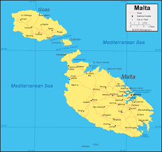
Background and context
COMPARE TO EUROPE AVERAGE
Population of Malta: 525,285
Nov 2021, Malta has registered 38,069 confirmed positive cases (0.07% of pop) and 462 deaths (0.0008%)
Italy (0.08%/0.002%)
Impact on key sectors of the economy, particularly: tourism, aviation and the service industry

Slide 30
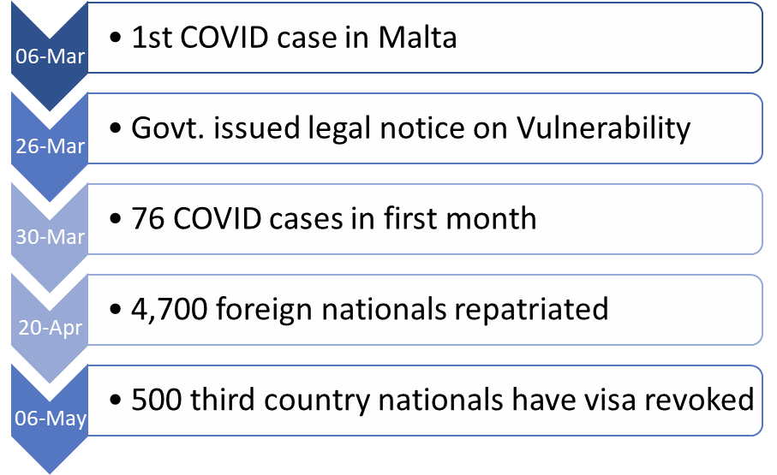
Background and context
-May 2021 Herd Immunity Reached.
-To date 82% of population Fully Vaccinated.

Slide 31
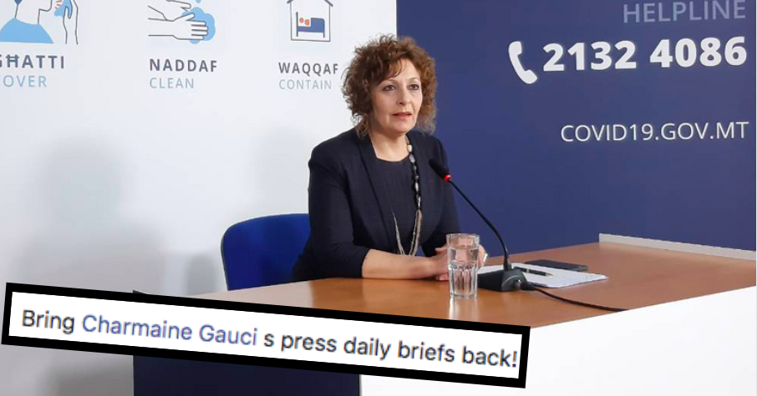

Trust and Medical Authorities

Slide 32
Background and context
Total number of interviews: 110
Interviewees recruited from across Malta, from various socio-economic contexts, representing a wide variety of categories of vulnerability.
54% described suffering from a chronic condition.
Entered into partnerships with various stakeholders: elderly care homes, mental health care providers, victims of domestic violence, the LGBTQI community and asylum seekers, among others.

Slide 33
2020-120,000ppl living with mental disorder in Malta [WHO 16/10/2020]
2019- 1,325 reports of domestic abuse
2020- 2,221ppl rescued at sea and disembarked in Malta
2020- >3,000ppl living in reception centres.
2019- 5,312 elderly in residential care.
[Formosa 2019]

Slide 34
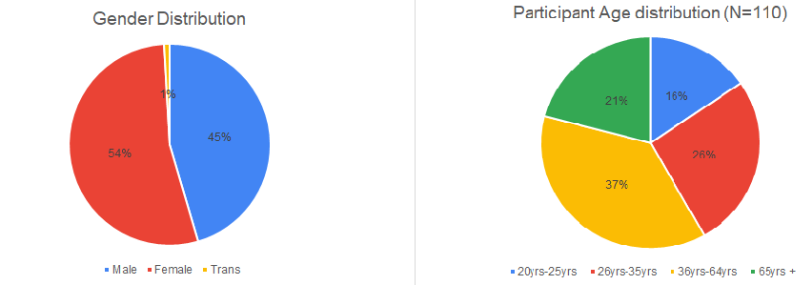

Slide 35
2020- 17.1% of population earns below 9k considered at risk of poverty

Slide 36
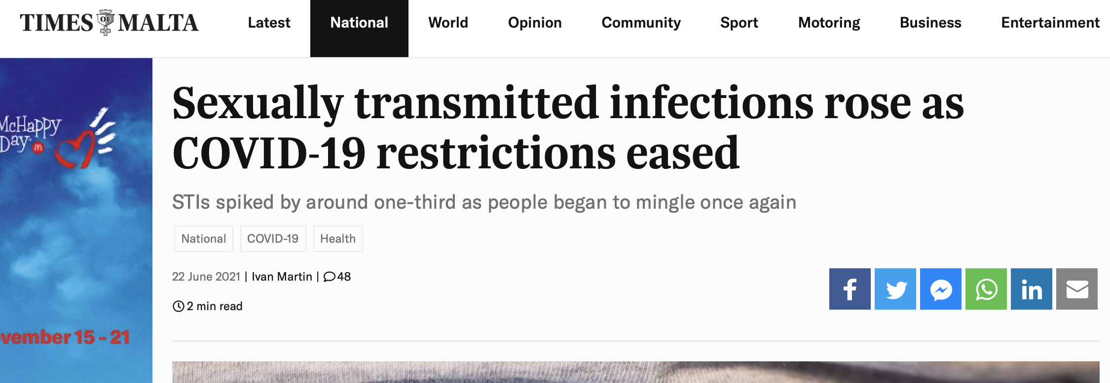
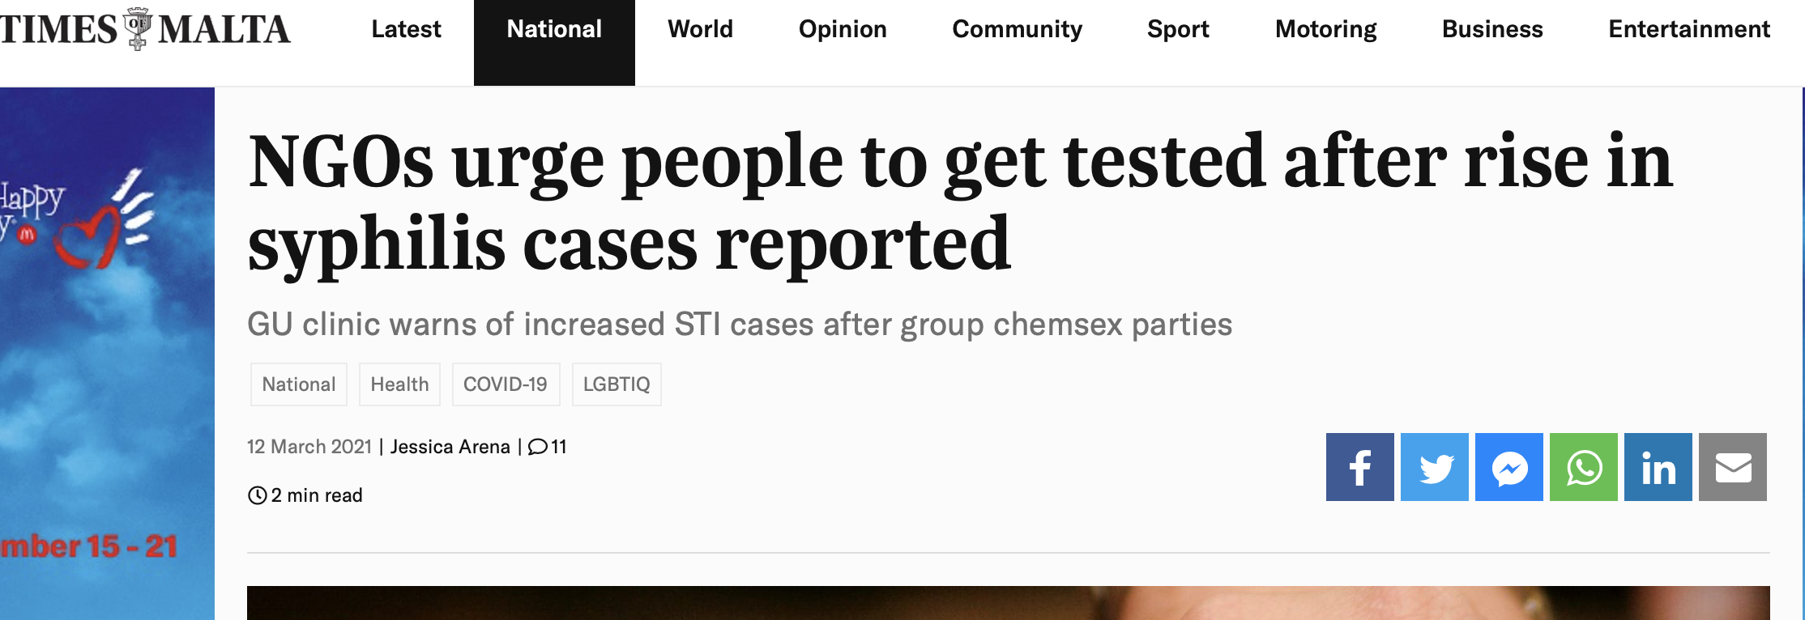
In 2018 European Centre for Monitoring of Diseases surveillance report on syphilis found 85 confirmed cases, translating to 17.9 persons per 100,000 population.
This is highest rate in Europe
2021- Minor outbreaks from sex parties, and swingers parties, ‘chemsex’ parties

Slide 37
Key findings
“I was scared to go to hospital because it was COVID as well and I'm vulnerable and I was scared that I was going to get COVID” [AC_160621_Lola].
31 unem. Maltese female, Fibromyalgia, Depression
“My dad around nine years ago had a heart attack. He got some chest pains and he was afraid to go to the doctor, because he didn't want to be sent to Mater Dei, because at Mater Dei you'll get COVID. He said, "If I go in, I won't come out”…lots of people put off going to the doctor because they were afraid of getting COVID.”
[MD_140621_ConniePt2]
39, Female, Teacher Maltese-British
•Interviewees reported reluctance to access essential medical services due to fear of getting COVID so they took questionable pre-cautionary behaviour over and above those recommended by the Health Authorities.

Slide 38
Key findings
“When we had the first cases, people would be like ‘Oh she has COVID, and she deserves it because she went here or there or wherever.’ Those are the things that people are afraid of, ... I think being stuck in quarantine and the social stigma that comes with it, I think that’s what people are afraid of” [GZ_180321_Veronica].
25, Female, Lab Technician, suffering MS.
Quarantine- generates stigma in close knit communities.

Slide 39
Key findings
“Okay, so quite a few beneficiaries have contacted us saying they've lost their jobs…because the shutdown of gastronomy and the hotel industry. And yeah, they have said I just cannot pay my rent at the end of the month. What can I do? Okay, can you help me? So you have to think about a referral or maybe try to find a way to speak with the landlord” [MS_220421_Giselle].
Non-Maltese nationals who are financially restricted (e.g. unemployment as a result of COVID) are further isolated through their lack of social networks and difficulty in accessing health, welfare or other state assistance.

Slide 40
Key Findings
You make the choices if you want to eat healthily or unhealthily, it's up to you, if you want to work out you'll find time to workout, you just have to make sure not to be tired, so that you'll have the strength, otherwise it's your own choice.
23Yr, Female, Learning Support Assistant
People prioritised individual reponsibility for health.
Based on ‘willpower’, ‘goal setting’, ‘positive outlook’. This also means that being unhealthy becomes an individual failure.

Slide 41
“Well, I think that people are what they are because of the way they eat. If you eat too much, why then do you moan that you are fat, if you are eating? In a certain way, you are what you eat. So you decide.”
[GZ-02/03/21_Alex]
50 yr old Priest
“Understand this, you are responsible for your own health. But many of them will say if you don't give me sauce, if you don't give me any joy in my food, what's left in life? And I usually respond. Well, what do you want to happen? You want to die in pain, at least die with dignity, without pain, close my eyes and just go not die with all that suffering. I wouldn't want to end up bedridden, unable to get out of the bed and up covered in bed sores, and dependent on medications. Especially since nowadays, there are so many awareness campaigns, and people have no excuse about not knowing what they're supposed to do to take care of themselves.”
[MS-20/09/21_Jimmy]
74, Male, Care Home Resident

Slide 42
Key findings
Jimmy, a resident in an elderly care home:
“Apart from the lack of communication, there's also the lack of family contact, because again, that's something that weighs on the mind. So people here will be asking, who knows what happened to them? Why haven't I seen them for so long. And not everyone had the same kind of access to Skype online facilities, even though these were being provided here, but not everyone knows how to use them” [MS_200921_jimmy]
Elderly populations reported difficulties in navigating information (including health related). They also reported greater feelings of isolation given the reliance of technology to communicate with others during the lockdown.

Slide 43
Key findings
Last week, there was this thing where over 50s could register for their COVID jabs, and it only worked if you had a Maltese ID card, which they very quickly said “it's a glitch in the system. We didn't do it on purpose”. It feels like it's intentional, even if it wasn't, it was probably a lack of foresight, but the lack of foresight also speaks volumes. All right, we're only thinking about ourselves. It's a huge damper on a sense of belonging [MS_220421_Giselle].
45Y Female, British Project co-ordinator
Lack of coordination of service support initiatives- related difficulty that people do not know of the services they are eligible for, highlighting feelings of isolation as a foreigner given their lack of family and social support networks.

Slide 44
‘Vulnerability’ as a medical-legal category
Medical vulnerability indicating likelihood of worse outcome and mortality related to biological state (even though latter is also influenced by environmental factors).
Vulnerability as a category that is legally defined and enforced.

Slide 46
The various categories are the following:
Persons who are 65 or over
Pregnant women
Persons suffering from various chronic illnesses or conditions including insulin dependent diabetics, persons suffering from cancer, or undergoing chemotherapy, patients on dialysis, or with respiratory or heart problems, patients on oral steroids, biologics or immunosuppressants.
Persons who occupy public office, are Members of Parliament, are employed in the health services sector or are themselves healthcare professionals or who occupy an essential headship position are exempt from this order unless they choose otherwise.
These categories of persons may leave their residence to attend medical appointments or to obtain medical care to acquire food, medicine other daily necessities or other urgent matters. However, they are obliged to limit the period outdoors to the least time possible and are to exercise social distancing.
Any further exemption is exclusively the responsibility of the Superintendent of Public Health.

Slide 47
Socio-Economic Vulnerability.
These were largely produced or exacerbated by the effects of measures to protect people defined as medically vulnerable.

Slide 48
After the beginning of the pandemic, finding a job is a problem, not like before, you cannot get a job. …
before working on the roads and in construction, everything in construction. I would work every day except Sunday, so Monday to Saturday and almost 12 hours, 7am till 8pm every day. The pay was 14 Euros for one day work, but sometimes, many times they don't pay. Sometimes we work with the Syrian people you cannot get paid here sometimes and so you go back home without money. We don't anything, nothing. Always at Hal Far. I don't understand, all these people they think we have COVID. "They're black they have the COVID already", people thinking like this. If you give them the CV now, they don't call, nobody calls and nobody cares and that's the problem. That's why there's no possibility for jobs now.
[MS 07_08_21] Sammy
23Y Male, Chad, unemployed, living in reception centre.

Slide 49
My boyfriend …he's a Hungarian living in Gozo. So he doesn't speak Maltese, he's not very familiar with the locals and doesn't really have a sense of community, because he's a foreigner. And he came here with practically nothing. And he managed to find a job just by a very random encounter, working on the Comino ferries, and that was going really well. And he was kind of building himself off to become a captain, because he was gonna start doing the captain's license for training and all that. But then obviously, the pandemic hit and of the tourism sector was one of the main areas that was affected by this whole pandemic, because it's a social, it's a social thing. So he ended up without a job, he was still getting like reimbursements but it didn’t compared to the amount of hours he was working for, and the pay he was making beforehand. So obviously, that's had quite an impact on him, the fact that he's unemployed at the moment, not getting much cash.
[GZ 23/04/21 Sarah]
21Y, Female,Maltese, Support Worker

Slide 50
Moral Vulnerablity
-Produced by competing moral imperatives, role expectations as kin obligations tempered by fear of illness or pressing economic needs.

Slide 51
Key Findings
I think in Malta there is a sense of trust … Or responsibility to others. And this kind of family environment really does help, I think, because everyone knows a nanna who passed away from Covid – a grandma or whatever – or someone’s grandma or someone’s aunty or someone. So I think that because it’s so close to everyone in a sense, people are more likely to believe in it and out of respect of these people or the families of these people, … For example, we have a very high vaccine uptake, and I think in part that’s why. … This idea that everyone is family or that we’re so close means that everyone knows each other and out of respect of my friend’s bużnanna who passed away from Covid, I’ll take the vaccine so I would protect other people like her, because I saw how distraught he was when she died, for example. That kind of thing. And I think as a community – as in the country; the population – makes us resilient against Covid in that sense.
[GO_21/05/21_Ruth]
23 rs Waiter/Student
Moral responsibility premised on kinship model.
However this can also lead to acute anxiety.

Slide 52
Key findings
I live with my dad who had cancer and was going through surgery at the time, so he was petrified, of course, even just to go out, he was scared to death. He'd rather that we didn't go out because he wasn't seeing people. I was really scared of getting COVID because it would have put him in a lot of trouble………
But people have to go to work, because they're not getting any other help [AC_280421_Tomasso].
Interviews highlighted contexts during the pandemic where people were forced to choose between two moral decisions, such as the duty of care towards vulnerable relatives and the need to maintain social distance from them out of fear of the possibility of infecting them

Slide 53
it's horrible, because you're sort of you're you're dependent on their services, dependent on their care, I can't very well leave with my children who needs care at the intensive care units. You know, they need need to be there and yet I don't have any control over who is in contact with them, who's wearing a mask and who isn't. The people who are meant to be watching out for this and making sure it doesn't happen, don't. I …t there were a couple of moments here and there, which sort of caused anxiety, and lots of anxiety. Because I mean, then, you know, as a parent, you just sort of, I don't know, you just want your kids to be with you and you want to protect them and do whatever you know, in this case, you just have very little control and you have to place a lot of trust in you know, the institutions, the people that are there. For someone like me, control issues, it's a challenge.
[MS-05/07/21] Mathilde
35Y, Female, Gozo, operations manager.

Slide 54
I was very scared. Sort of avoiding touching, excessive cleaning, I became very aware. And I was more scared of what could happen to my parents. I decided to stay there. I could have been repatriated, but I didn't want to so I stayed there, with my parent’s blessings... When I came back, I had that phase where I was, again, very scared. Again, because of my parents I was never scared that I get it. My only fear was giving it to someone else. I said, this is the new life, we just have to live with it.
[AC 16/06/21] Michael
27Y Male, Maltese, Community Worker

Slide 55
Policy Recommendations
DIGITAL LITERACY- Education attempts should target elderly populations, particularly those living in residential facilities through private public partnerships.
MENTAL HEALTH- The stigma associated with mental health conditions has been widely recognised even at a policy level. The Mental Health Strategy 2020-2030, needs launched prior to the onset of the pandemic needs to be re-assessed in light of mental health services accessibility in COVID-19.

Slide 56
Policy Recommendations
CO-ORDINATION- The amount and level of support services varied greatly among vulnerable groups. There is a greater need for integration of services between different entities at a horizontal level, as well as greater integration within national structures. A co-ordinating structure, should be developed to integrate stake holders at both public and NGO levels to improve dissemination and coordination in both Maltese and English.

Slide 57
Policy Recommendations
ACCESS TO GREEN SPACES- The pandemic has made people more aware of the connections between access to green open spaces, mental well-being and the ability to maintain a healthy lifestyle. Interviewees have noted the need to extend current limitations on construction noise in urban areas, and the broader encroachment of construction in green areas.

Slide 58
Greater attention needs to be placed on the effects of mitigation measures and the vulnerabilities produced therefrom. Policy needs to go beyond adressing vulnerability as a medical-legal catgeory but needs to look at vulnerabilities from a more holistical and longitudinal approach.

Slide 59
Italy key findings and policy recommendations
Ketty Vaccaro, Fondazione Censis
Paris, 19 November 2021

Slide 60
Summary
Vulnerability categories
Some new findings compared to the initial categories
Some changes related to COVID-19 pandemic
Key findings
The general impact of the pandemic on health
The general impact on economic conditions
COVID- 19 vulnerability due to health conditions
Other types of Vulnerability
Some insights for an action plan

Slide 61
The sample
 | v.a. | %
Age (From 18 to 91)
Up to 30 | 43 | 22,6
31 - 45 | 75 | 39,5
46 - 60 | 39 | 20,5
Over 60 | 33 | 17,4
Gender
Women | 99 | 52,1
Men | 87 | 45,8
Other | 4 | 2,1
Location
Urban (Rome) | 101 | 53,2
Rural area (Other Latium municipalities) | 89 | 46,8
Modality for interview
In presence | 75 | 39,5
Web/telephone | 115 | 60,5
Total | 190 | 100,0
The first step of the V.A. concerned the realization of 200 qualitative interviews ( of which 190 valid ones) to people with different types of vulnerability conditions.
In the table you can find the general characteristics of the interviewed people

Slide 62
Main Vulnerability categories
 | v.a. | %
Lonely people | 31 | 16,3
Seniors over 70 | 15 | 7,9
Families with disabled or non self-sufficient elderly / disabled / people with Down syndrome, etc. | 9 | 4,7
People with cronic desease | 47 | 24,7
Families with children up to 14 years/single-parents families | 26 | 13,7
Students in DAD | 21 | 11,1
People in precarious housing | 12 | 6,3
Earthquake victims | 7 | 3,7
Nurses | 8 | 4,2
Caregivers (professional) | 7 | 3,7
Caregivers (familiar) | 10 | 5,3
Teachers | 2 | 1,1
Deniers about Covid | 8 | 4,2
People with psychological problems | 6 | 3,2
Transgenders and non binary | 2 | 1,1
Women victims of violence | 1 | 0,5
Families with financial difficulties | 29 | 15,3
People with familiar troubles (in difficult divorce process) | 6 | 3,2
People who have had Covid or Long Covid | 13 | 6,8
Smartworkers | 23 | 12,1
Show business workers / dealers in penalized sectors | 17 | 8,9
Unemployed | 22 | 11,6
Precarious workers | 37 | 19,5
Workers temporarily suspended from work with partial wages (Cassa integrazione) | 12 | 6,3
Immigrants | 12 | 6,3
Total (Valid Interviews on 200) | 190 | 100,0
8 new categories compared to the initial categories
44% of respondents have more than one vulnerability
75% of the sample had a pre-existing vulnerability (but 25% had no vulnerabilities unlike what we expected)
We found new vulnerabilities due to COVID-19 in 55% of respondents without vulnerabilities and in 63% of people who had initial vulnerabilities
40% of people with initial vulnerabilities shows an increase in vulnerabilities
New vulnerabilities and increased vulnerabilities are more common among those with more than one

Slide 63
A multi-dimensional vulnerability
Woman, 40 years old, foreign, lives in Rome
She studies medicine and works as a waitress, after going on layoff for COVID-19 she no longer has sufficient income and found a work in a call center
She doesn't feel integrated in the place where she lives and she thinks that there are problems of integration that concern all foreigners towards whom there is a lack of interest from public institutions and also the associations of the third sector don't do enough
Vulnerability is a mix of loneliness, uncertainty, anxiety, financial and health problems
"I know people who are not doing well at the moment both economically and mentally. If one is sensitive or in difficult situations the body is affected. If a person is alone, has to support himself and does not have economic security, these elements affect the rest. And everything is increased by the anxiety of the moment."
Living conditions and discrimination against foreigners create more
forms of vulnerability
"There are people of different nationalities and I think they are quite neglected. Their lifestyle and the environment they live in increases their health risks. My guess is that they don't even get tests for prevention and even forgo medical care for economic reasons of course. Those who work off the books would rather go to work even if they're sick than miss a day of work that won't be paid."

Slide 64
The double vulnerability of the disease
Woman, 35 years old, lives alone, outside Rome
She has chronic diseases and is obese, has long-COVID
She lost her job because of COVID but recently found another one
Her illness had a major impact on her living situation (her boyfriend left her when he knew she was sick) but COVID also created psychological as well as physical problems to her
She believes that a healthy environment is strategic to health, and likewise, good social relationships, which it is up to us to create
The psychological vulnerability related to COVID
"The COVID had a strong emotional impact for me both physically and emotionally. I had to do two quarantines (40 days + 40 days). The fact that I can't get a hug or the fact that I can't invite people, to not see them physically at all has changed me so much.“
"for months I felt that I had experienced a period of extreme loneliness."
Work as a tool for resilience
“The biggest concern for me is having a stable job. Now that I have a job that I thought I couldn't do because of my physical problems, I feel more positive about facing life”

Slide 65
A different impact of COVID on health
Man, 42 years old lives in Rome
entertainment worker stopped working because of COVID
He is overweight
He has economic aid and food parcels
He has developed a phobic attitude towards COVID and has not left the house during a long period
He thinks that the physical and social environment have a strong impact on health
The worsening of a psychological problem
“Contamination phobia began to prevail with COVID, greatly affecting my life. My life is completely altered by COVID”.
The improvement of an unhealthy lifestyle
“I lost 25 Kilo. I think it depends on the absence of the alcohol that was part of my nights out, even though I didn't have any problems, it was related to the sociality”

Slide 66
The impact of the pandemic on health
57% during the last 3 months was unwell (at least one day)
49% changed his weight due to the COVID
45% doesn't sleep well and among them 27% for the stress due to the COVID

Slide 67
The impact of the pandemic on employment and economic conditions
48% of the VA sample has experienced a change in income due to the COVID pandemic and, among those, 43% believes that it will not return to pre-pandemic levels
60% is working, but almost 10% lost his work due to the COVID or is furloughed (cassa integrazione) due to the COVID
50% are in smart working due to the COVID

Slide 68
COVID-19 and vulnerability linked to health conditions
The health consequences of COVID (including psychological and mental health) tend to be more severe in the presence of existing health vulnerabilities (chronic diseases, disabilities)
Reduced sociality creates anxiety and depression
“So this is the situation inside the house (two disabled parents), so imagine with Covid how I was obviously, we were extra careful, it was just absurd. that is, we all had to be careful because that applies to everyone, plus we really haven't done anything this year, nothing, always inside the house”.
“Because of the COVID by reducing sociality I am sadder, I struggle to do things, study, I sleep more”.
Deterioration of healthy lifestyles (diet, physical activity, etc.) is widespread
"With this pandemic, then, just... just eating you could, so, then I was ordering from fast food restaurants a lot in the evening, like twice a week.

Slide 69
COVID-19 and other vulnerabilities (1)
“The pandemic has created new poor and therefore these new poverties are not covered"
The more quoted form of vulnerability due to COVID is the economic one
“For COVID, restaurant and pub owners and sports workers, who often do not even have a contract, are economically vulnerable”
"Until two years ago I was earning 2000-2500€ per month, and now for a reason, yes, they explained it to me, but nobody cared that I had a job and I have nothing anymore"
“Those who have experienced employment difficulties. Immigrants or those without a permanent job are more vulnerable”
The consequences of COVID tended to be more severe for those who had previous or intervening economic vulnerabilities
“For this month they gave me 200 euros. In April we don't know, we have to reapply. At the moment I feel a bit humiliated.
Because it's like they're begging me. . Then I got over it, I bought some food, and I didn't care a bit."
“A precarious person is economically vulnerable. He is someone like me. If I don't have 30 hours of lessons, if I only have 10, two people tell me from tomorrow that they don't have the money for the lessons and I can't buy food anymore. And maybe they are also prevented from doing their job, like me in the red zone”

Slide 70
COVID-19 and other vulnerabilities (2)
“The elderly are more at risk, they have a weaker immune system”
Vulnerability to COVID depends not only on health conditions but also on income, cultural aspects and behaviours
“Vulnerable are those who have financial difficulties and cannot treat themselves well”
“Those who do not follow the rules indicated are more at risk for COVID”
“At risk are those who, due to misinformation, underestimate or do not believe in the existence of the virus”

Slide 71
Strategic factors for health and well-being
“Health is a matter of choice as well as luck”
“Making decisions to maintain a healthy lifestyle is a personal choice, especially the diet”
More generally, there is a widespread belief that individual behaviour, environment and social relationships are strategic factors on which health depends
“The optimistic or pessimistic attitude is also important. Negative energy affects the organs and the mind”
“The environment is very important. I would like to have an outdoor space and places to go walking closer”
“Both the physical environment, the greenery rather than the buildings, and the environment in terms of the people around us are very important”
“The physical environment determines a lot, think of cancers that arise from complicated environments, complicated food. And then the social environment, collective behaviour, is important”
“Having a good social and emotional stability also helps a lot in healing”
"Loneliness kills people, loneliness is not a good thing, especially when you are sick"

Slide 72
Some insights for an action plan
If the vulnerability is multidimensional, the intervention must be multidimensional too: not only health and social policies, but also work, environment and information must become objectives of an effective action against vulnerability that has to involve several actors
reducing difficulties in accessing services due to economic problems (waiting lists, co-payments, regional differences, …)
rethinking the common spaces of the city that are a source of resilience. Green spaces and meeting places are important for physical and mental health but also for social integration
making some emergency solutions structural - financial aid, educational support, etc.- for precarious workers and those on the edge of the poverty line (and at risk of becoming poor)
reviewing employment policies by reducing the gap between protected and precarious workers
involve non-profit organisations in social and city policy choices and support their actions in favour of the community
shifting the focus from hospital to community and home-based services
rethinking responses to the needs of the elderly: isolation at home with a caregiver often does not work better than staying in a nursing home with a small number of poorly qualified workers
improving health information and taking into account different levels of education and health literacy

Slide 73
Vulnerability Assessment, Munich
Germany – Munich
Zeliha Öcek¹⁻³ , Michaela Coenen¹⁻² , Vera Klünder¹⁻²
1 Institute for Medical Information Processing, Biometry, and Epidemiolgy – IBE, Chair of Public Health and Health Services Research, LMU Munich, 2 Pettenkofer School of Public Health, Munich, Germany, 3 Rachel Carson Center for Environment and Society
Paris, November 2021

Slide 74
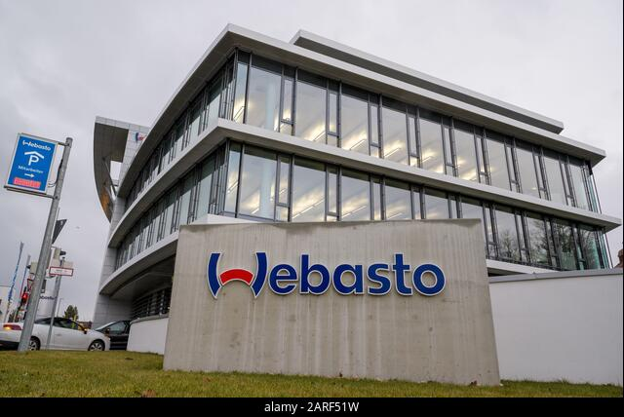
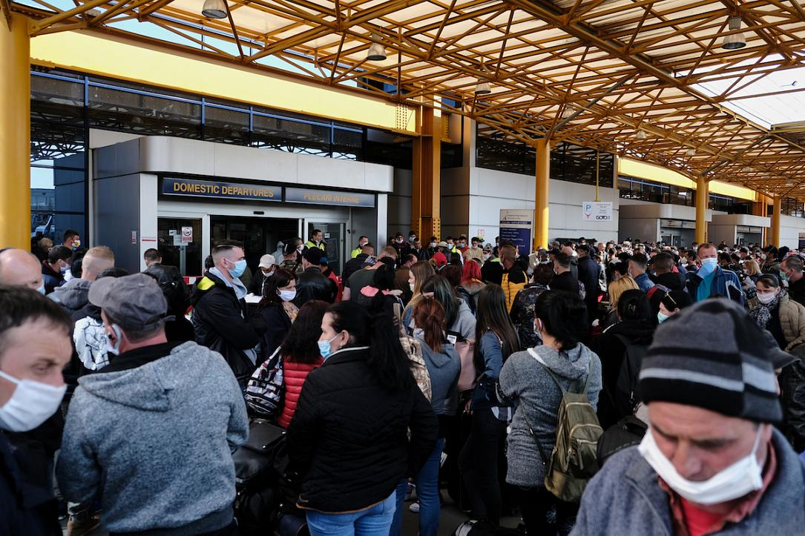
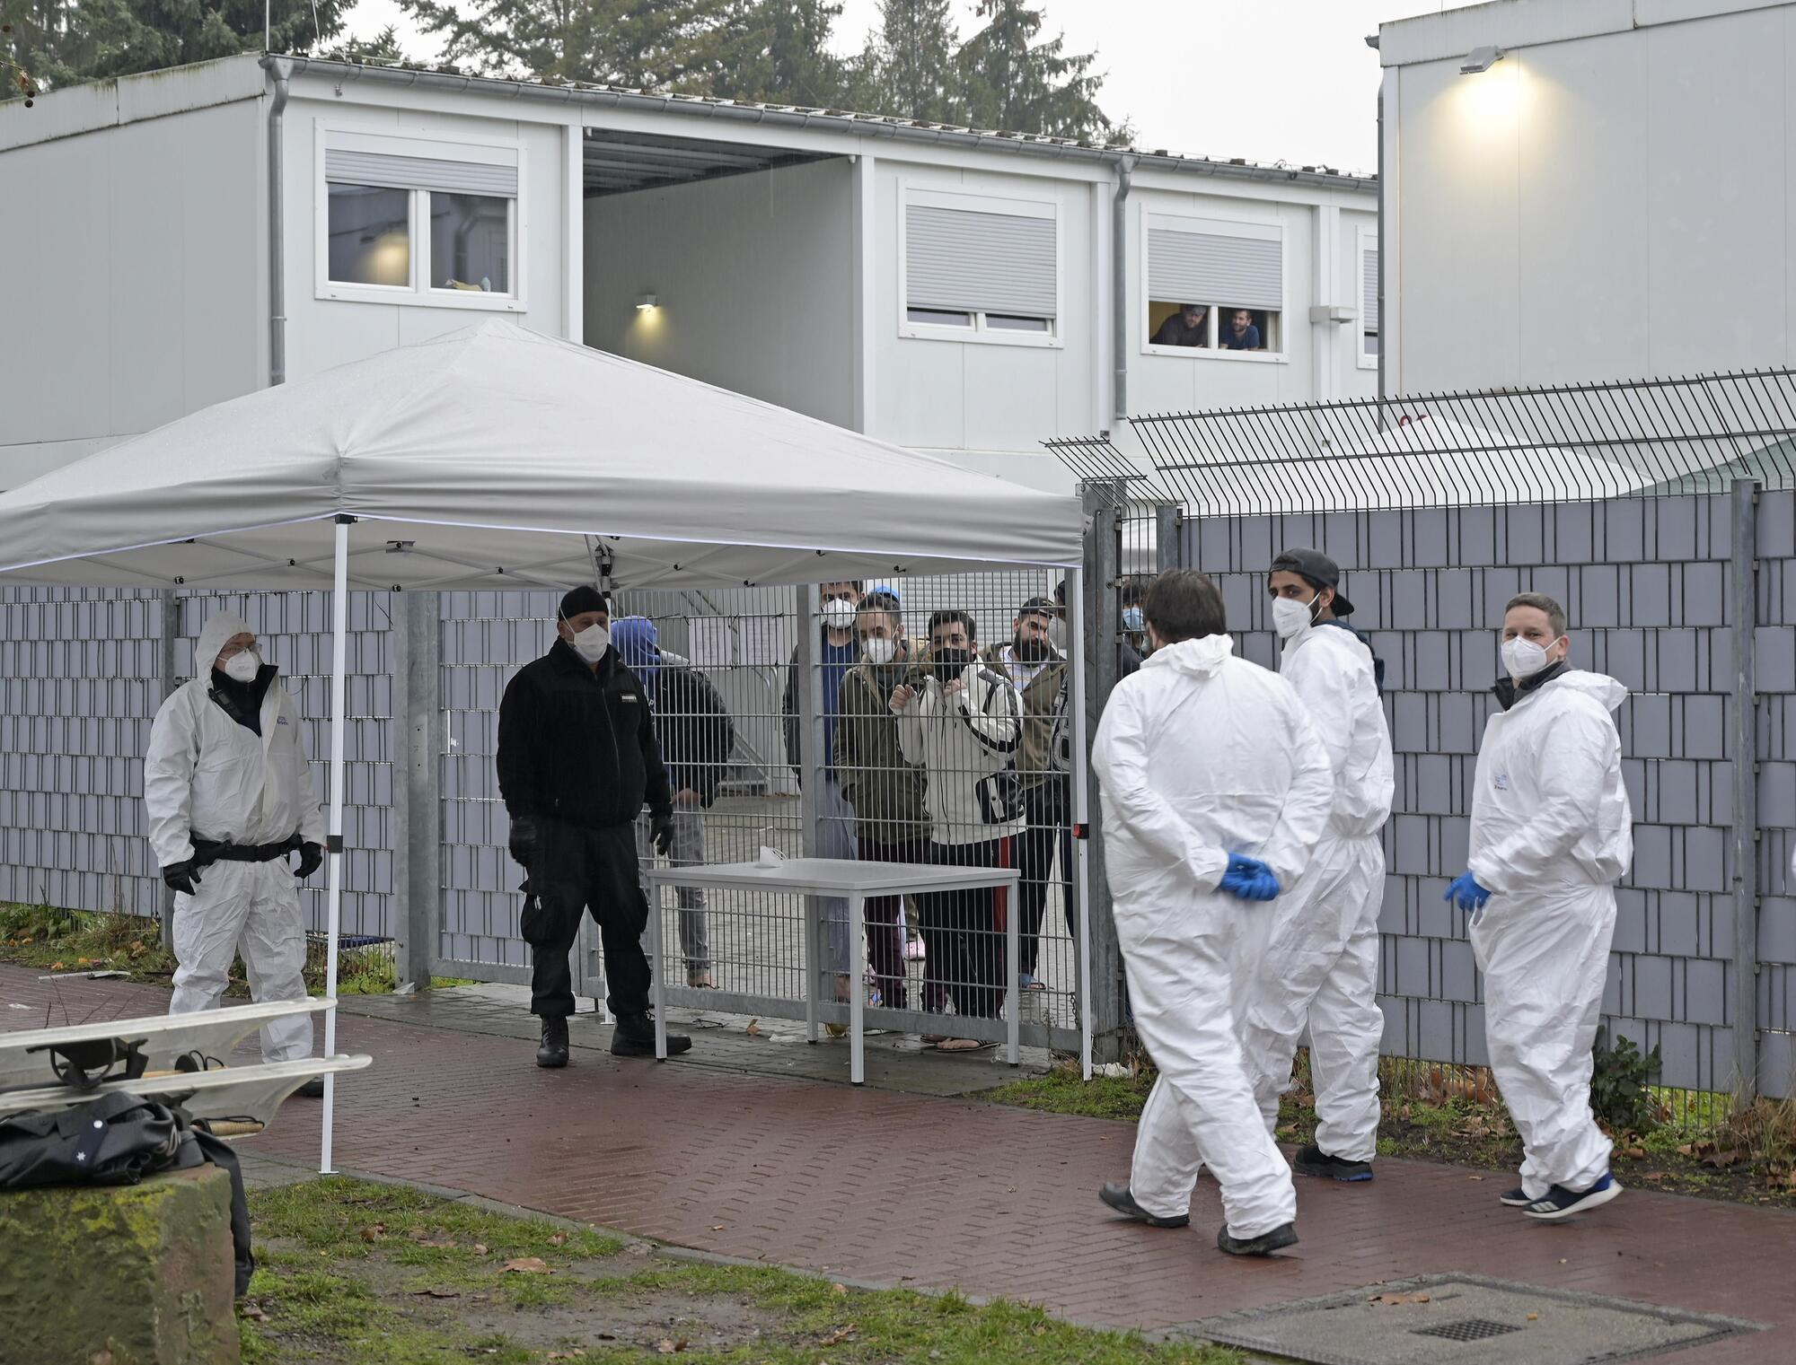
Munich and COVID-19
First case of COVID-19 in Germany: 27.01.2020, Munich, Starnberg
An epidemic that starts with the rich and healthy,
spreads to the poor and vulnerable people

Slide 75
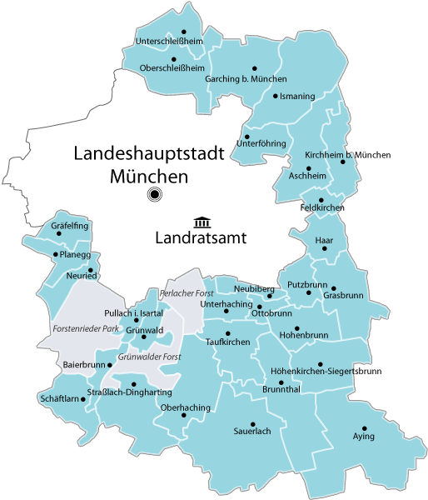
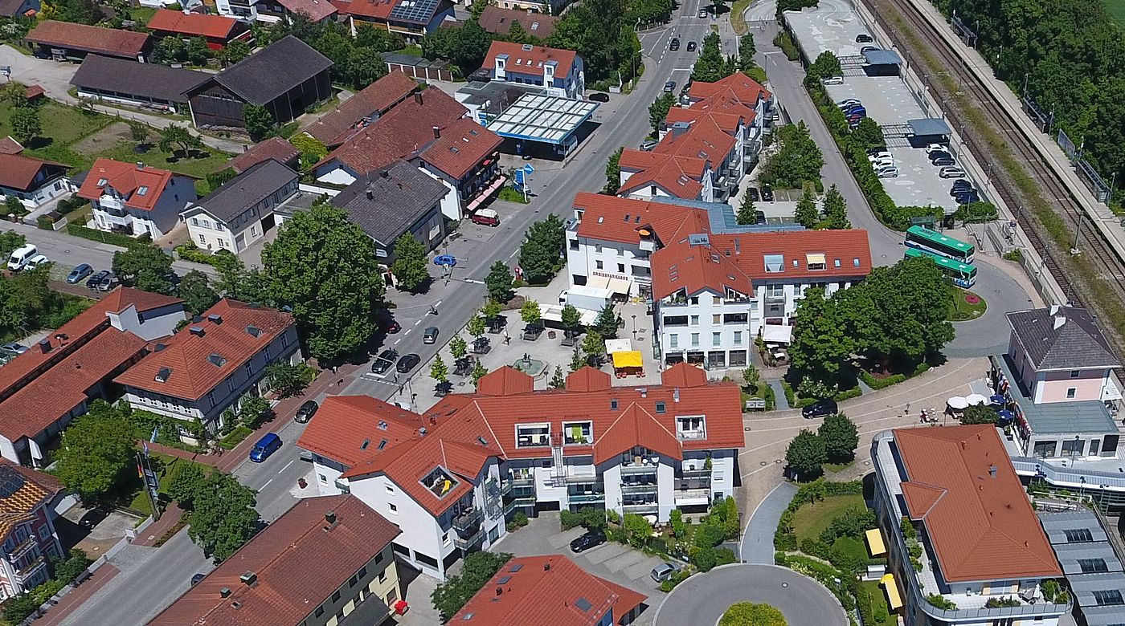
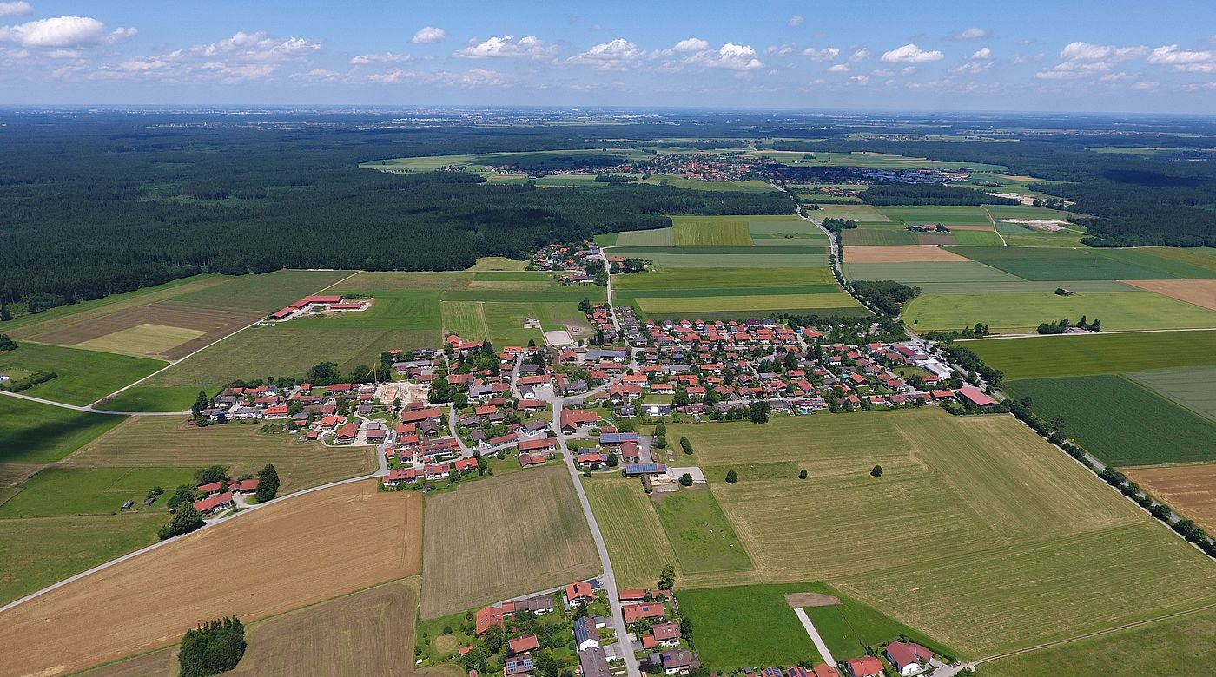
Vulnerability Assessment Interviews: 80 people
Expert / Community Member Interviews: 20 people
Main Groups
Students (national, international)
Refugees / Aslyum seekers / Migrants
Disabled people
People with considerable mental problems
Health care / social care workers
Educators
Members of LGBTQ+ community
Elderly people
People with severe chronic diseases
Unemployed people, …
Multidimensional vulnerabilities
Asylum seeker, disability
Student, healthcare worker, drug consume, migrant community
Short term work, mental health
Trans person, coloured person, chronic disease
….
Country of origin | N
Germany | 43
Afghanistan | 8
Turkey | 4
Greece | 2
USA | 2
Syria | 2
India | 1
Colombia | 1
Eritrea | 1
South Korea | 1
Syrian | 2
Pakistan | 1
Bulgaria | 1
Kenia | 1
Georgia | 1
Somalia | 1
Uganda | 1
Iran | 1
Netherlands | 1
Poland | 1
Bosnia | 1
Austria | 1
Urban: 53, Rural: 27,
Notes:
draft manual ile karşılaştırma ve uyumun sağlanması
no subcodes for the first round of coding

Slide 76
Question 1: Why was life much harder for some than others in Munich ?
FINDINGS: Vulnerability and resilience mechanisms in Munich before the pandemic
Mechanisms
Structure: Capitalism, Colonialism, Racism, Paternalism
Mechanisms
Structure: Democracy, Rights, Law, Local Government
Discrimination, Stigma and Violence
-According to race /ethnicity, sex, age, health, social class, religion, appearance, legal status
-In community, healthcare, police, institutions, NGOs, education, housing, social services
Insecurity
Income, Housing, Legal status, Job
Working life
Workload, Occupational risks
Two-class, Market- and Western-oriented Medicine
Healthy city: Green, Safe, Access to safe water,
Family- and Child-, Disability-friendly
Strong healthcare and social benefits
Strong social services network
Respected scientific institutions
Support for integration
-for disabled people, migrants / refugees, elder people
VULNARABILITY
RESILIENCE
Individual Variables:
Age, Sexual identity, Race, Religion, Language, Health status, Disabilities, Past traumas/ operations, Family issues (young children, ..), friends etc
Results
Results
Distrust, Loneliness and isolation,
Stress, Worries, Unhealthy lifestyle
Trust, Healthy lifestyle,
Feeling of wellness

Slide 77

People among us:
Iman, 25 yrs old, female, master student from Iran
Question 2: How has the pandemic changed the lives of vulnerable people?
Before the pandemic
Loneliness except the community from Quran course
Stress and stigma regarding hijab
Sanctions: Inability to receive money via bank transfer
With the pandemic
Expired residence permit, she couldn’t go to Iran, financial problems, increased level of stress
A range of different symptoms
  Lymphadenopathy operation, increased feeling of loneliness
  Autoimmune disease: Sjogren syndrome
  Distrust of diagnosis and out-of-pocket payments for medicines
Anxiety of being infected with COVID-19 and staying in quarantine
I lost my interest about my life and health recently, and I am getting week

Slide 78

People among us:
Werner, 60 year old man with cognitive disabilities and psychiatric problems
Before the pandemic
Traumatic events he has experienced in institutions for the disabled since his childhood (paid compensation)
Supported workplace (art studio) and accommodation «Nominated for European Art Prize for Art in Disability»
With the pandemic
Loneliness, emptiness and depression because of not being able to go to work
I almost took my life. Nearly. I already told my psychologist. Then he calmed me down, he said, "Let's see that you can go back to work".

Slide 79
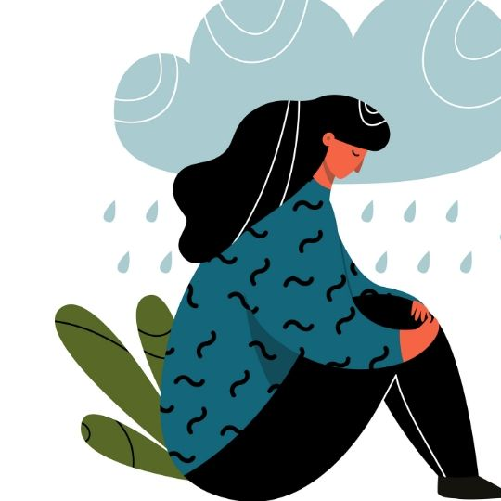
People among us:
Leyla, 53 yrs old Turkish woman living alone
Before the pandemic
Lost of her 15-year-old daughter + Traumatic experiences with healthcare workers
No family support, receives social assistance
Received psychiatric support for a while
Diabetic
Poor German skills. Burden of bureaucratic work. eg. struggling to recover out-of-pocket payments for medication
Students from Turkey like her daughter «rainbows»
With the pandemic
The burden of bureaucratic + online work has increased
Gained excessive weight, unable to go to health check-ups, increased loneliness and depression
I've been separated from my rainbows because of these bans

Slide 80
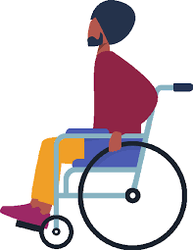
People among us:
Muhammad, 32 yrs old, male, refugee from Somalia
Before the pandemic
Disabled due to a gunshot wound, had surgery in Germany and was hospitalized for five months.
Lives with his wife in a container with 400 people, no residence permit
Rehabilitation request not accepted, trying to do sports
Stigma regarding being Muslim
Tries to learn German to find a job and to integrate, his wife is working
With the pandemic
Infected with COVID-19, quarantined and unable to exercise
Still trying to have rehabilitation
Online German course
I want rehab. They always say. Wait. No response. To be patient. … General practitioner, change the wound once a week. Urology doctor, going to appointments yourself, always doing everything on your own.
Quarantine is not that easy, ... don't go outside, then the bed is not so good.

Slide 81
The capacity of pre-existed factors to cause vulnerability or resilience, the evolution of this capacity with COVID-19, and the emerging vulnerability or resilience factors with COVID-19
Question 3: Which vulnerability mechanisms were strengthened by the pandemic?
Insecure legal status
Job and income insecurity
Stres and unhealthy lifestyle
Worries
Loneliness
Workload and occupational risks
Distrust
Discrimination, stigma, racism
Insecure, unstable, unafforadble housing
Social barriers to care, biomedical approach
Increasing Role / Emerged with COVID-19
Violence
Gender
Financial barriers
to care, market-orientation
Unfriendly neighborhood for Non-Germans and LGBTQ+
Increasing Vulnerability
Individual variables
Increasing Resilience
Vulnerabilty factors
Decreasing Role with COVID-19

Slide 82
The capacity of pre-existed factors to cause vulnerability or resilience, the evolution of this capacity with COVID-19, and the emerging vulnerability or resilience factors with COVID-19
ö
Long COVID
COVID-19 Rules, Quarantine
Untailored information on COVID-19 and infodemic
Vaccine hesitancy
Insecure legal status
Job and income insecurity
Stres and unhealthy lifestyle
Worries
Question 4: What are the new vulnerability mechanisms that have emerged with the pandemic?
Loneliness
Workload and occupational risks
Distrust
Discrimination, stigma, racism
Insecure, unstable, unafforadble housing
Social barriers to care, biomedical approach
Increasing Role / Emerged with COVID-19
Violence
Gender
Financial barriers
to care, market-orientation
Unfriendly neighborhood for Non-Germans and LGBTQ+
Increasing Vulnerability
Individual variables
Increasing Resilience
Vulnerabilty factors
Resilience factors
Decreasing Role with COVID-19
With COVID-
19 new
emerged
factors

Slide 83
The capacity of pre-existed factors to cause vulnerability or resilience, the evolution of this capacity with COVID-19, and the emerging vulnerability or resilience factors with COVID-19
Long COVID
COVID-19 Rules, Quarantine
Untailored information on COVID-19 and Infodemic
Vaccine hesitancy
Financial support or bonus regarding COVID-19
Access to information
COVID-19 Test
COVID-19 Vaccination
Insecure legal status
Job and income insecurity
Stres and unhealthy lifestyle
Worries
PPE
Access to COVID-19 treatment
Social media
Loneliness
Workload and occupational risks
Distrust
Support from family
Discrimination, stigma, racism
Insecure, unstable, unafforadble housing
Unproductive free time
Supportive physical environment
(green city)
Increasing Role / Emerged with COVID-19
Gender
Financial barriers
to care, market-orientation
Social barriers to care, biomedical approach
Violence
Unfriendly neighborhood for Non-Germans and LGBTQ+
Supportive social environment
Healthy
lifestyle
Increasing Vulnerability
Individual variables
Increasing Resilience
Question 5, 6:
Which resilience mechanisms have become more important in the pandemic?
Are there any emerging resilience mechanisms in the pandemic?
Vulnerabilty factors
Resilience factors
Decreasing Role with COVID-19
With COVID-
19 new
emerged
factors

Slide 84
The capacity of pre-existed factors to cause vulnerability or resilience, the evolution of this capacity with COVID-19, and the emerging vulnerability or resilience factors with COVID-19
Long COVID
COVID-19 Rules, Quarantine
Untailored information on COVID-19 and infodemic
Vaccine hesitancy
Financial support or bonus regarding COVID-19
Access to information
COVID-19 Test
COVID-19 Vaccination
Insecure legal status
Job and income insecurity
Stres and unhealthy lifestyle
Worries
PPE
Access to COVID-19 treatment
Social media
Loneliness
Workload and occupational risks
Distrust
Support from family
Discrimination, stigma, racism
Insecure, unstable, unafforadble housing
Unproductive free time
Supportive physical environment and housing
Increasing Role / Emerged with COVID-19
Gender
Financial barriers
to care, market-orientation
Social barriers to care, biomedical approach
Violence
Unfriendly neighborhood for Non-Germans and LGBTQ+
Supportive social environment
Healthy
lifestyle
Increasing Vulnerability
Individual variables
Increasing Resilience
Strong structure of healthcare
Healthcare insurance
Vulnerabilty factors
Surrounding
facilities
Disability- friendly city
Question 7: Which resilience mechanisms no longer work during the pandemic?
Resilience factors
Trust
Living in islands
Social care and support for disabled, elderly and sick people
Decreasing Role with COVID-19
With COVID-
19 new
emerged
factors
Self-determination
Social care and support for famililies, children and students
Integration, social care and
support for refugees

Slide 85
    Key Findings
    Asylum Seekers and migrants deeply affected by the pandemic
    Strategies applied for the privileged class are not realistic for them
    People with disabilities experienced difficulties due to COVID-19 measures
    Support interrupted due to the pandemic
    The poor ones were affected the most, but there are also middle-income people who are vulnerable
    Mental health is more important than ever. Young people !
    Uncertainty, helplessness, anxieties, loneliness and isolation caused by the pandemic
    No new promising resilience mechanisms and solidarity stories
    A vulnerability triangle
    Munich is a city for German, wealthy, educated, heterosexual people with families
    The pandemic has strengthened the ties between poverty, immigration and insecure housing
Poverty
Insecure Housing
Immigration
COVID-19

Slide 86
Policy Recommendations
To repair the damage caused by the pandemic measures, to reduce the ongoing threat, and to have better response to the following threats
Supporting people with long COVID, providing job security
Tailored preventive services (health education, vaccination, ...) according to different groups and ensuring access to all segments of the society
Pandemic measures that will not interrupt support services for special needs
Mental health services in different languages
Digitalization in all areas and accessibility of IT equipment / infrastructure
IT tools suitable for the use of disabled and elderly people
Improving the shelter conditions of refugees
Main Recommendation: A stronger fight with the existing structural elements and the mechanisms
Human rights perspective and equality in social determinants of health
Starting point; secure, healthy and affordable housing

Slide 87

France Vulnerability Assessment
Tamara Giles-Vernick
Team: Papa Mamadou Diagne, Benedetta Lana, Milena Reig, Daria Rostirolla
Anthropology & Ecology of Disease Emergence Unit

Slide 88
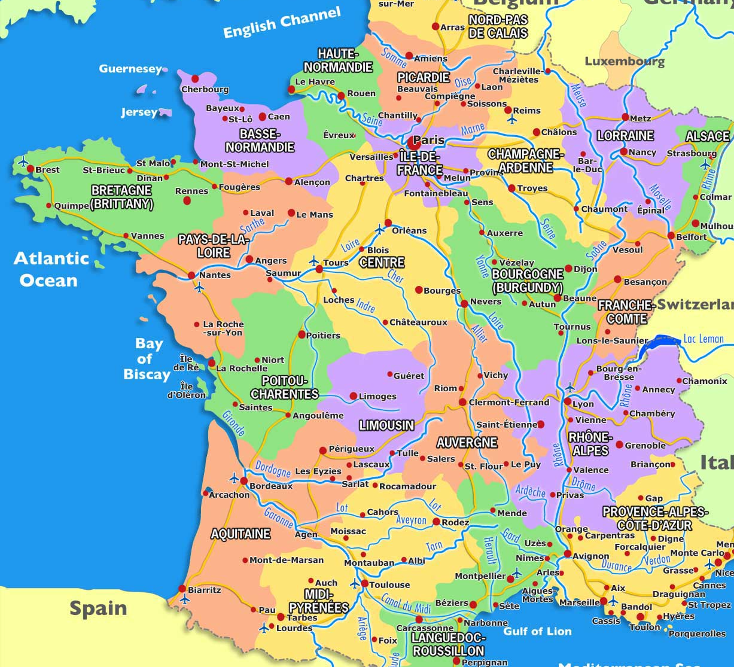
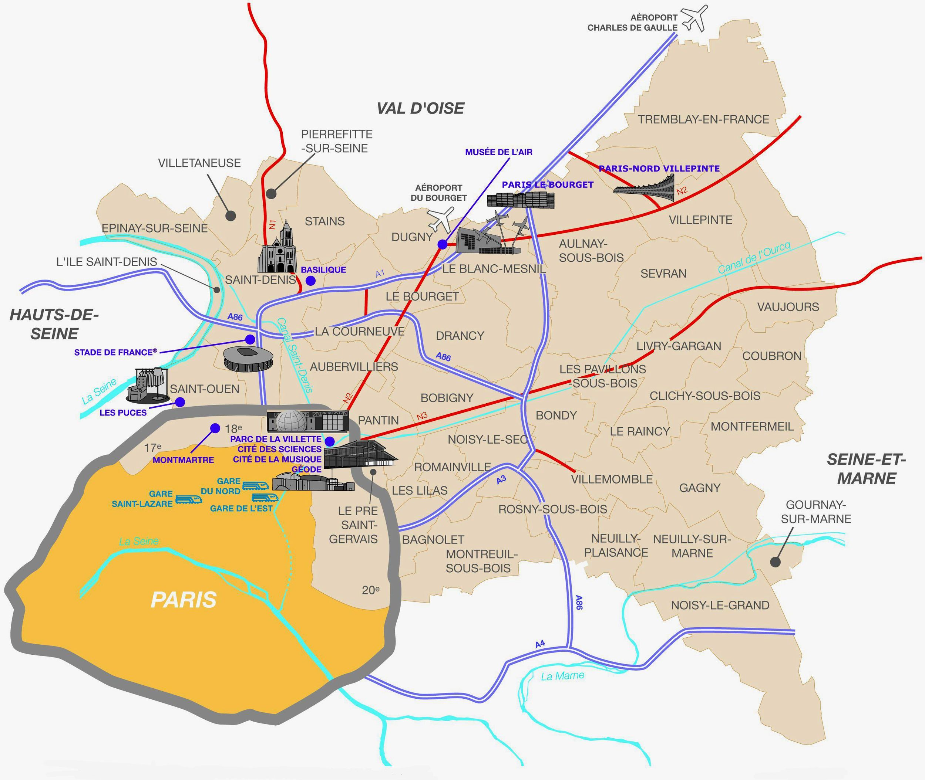
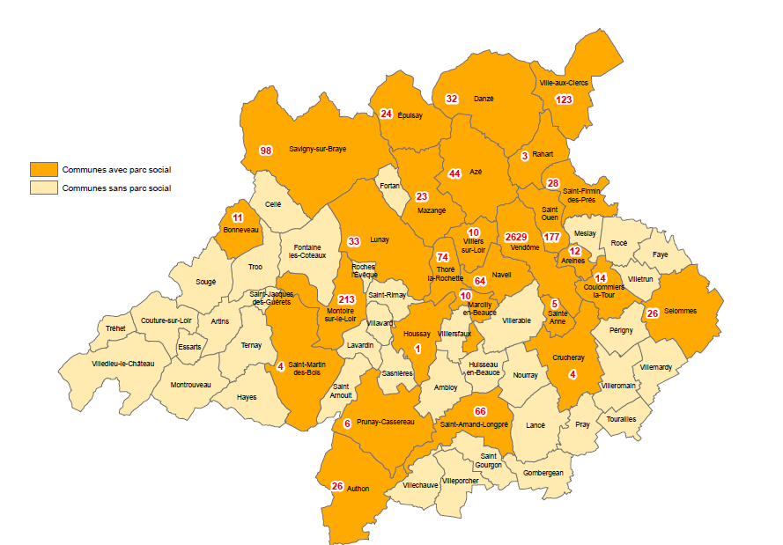
RESULTS:
Paris & Seine Saint Dénis: 109
Communauté d’Agglomération Territoires Vendômois: 43
Interviews with actors on the ground: 20
Action and Advisory Committee (multiscalar, multisectoral engagement)
pop ~12 million
pop 53 000
Notes:
60% women, 38% men, 4% nonbinary between ages of 18 and 95
62% with a chronic illness

Slide 89
Qualitative analyses : 3 themes
Institutional barriers to human agency
Barriers to accessing aid & assistance
Loss of confidence in government, certain professions, etc
Notes:
Not spending much time on distributions, but prefer to focus on qual results

Slide 90
Institutional barriers to human agency (hospitals, nursing homes, pedagogical institutions, institutions for those seeking asylum, emergency housing centers)
Sense of abandon-ment
Incertitude
Loss of capacity to make decisions; initiative, meaning
Severe social isolation
Nursing home resident:
« I am waiting for death. And I hope that it isn’t too far off. »
Staff silences around sicknesses and death in nursing homes
Notes:
Engagement w/Institutions designed to assist; but rendered people more vulnerable in short and longer term to declining health thru massive constraints on agency. Did so in different ways, but will take example of nursing home resident; Resident came in just prior to epidemic outbreak, against her own desire to remain living independently. Shutting down of all activities and family visits: enhanced emotional fragility, sense of being abandoned; deep uncertainties bc disjuncture between news and silence on part of personnel (don’t know who is sick, who died): ‘I am waiting for death, and I hope it isn’t far off. Loss of initiative, lack of meaningful activities
Point here repeated across different kinds of group: Younger populations – students – similar sense of abandonment, loss of objectives, rudderless: incertitude about job mkts: generation@risk
Efforts to curtail transmission thus affect those engaging with institutions designed to assist, but constrain agency, → damaging effects on mental health, and over longer term, potential effects on health in broadest sense

Slide 91
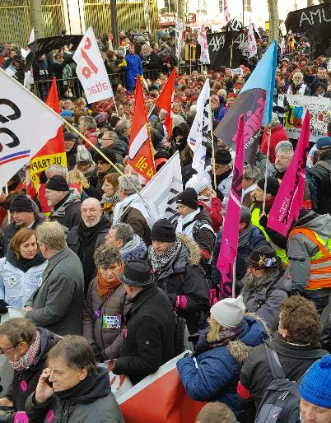
Trust
Government
Medical professions
Media
Opposition: « us » vs political class
Incoherent control strategies
Women’s chronic pain
Infodemic (abundance of contradictory information)
Political class + media
→ Loss of liberties
Triage and « Tuning out »
Medicos in the media
Reproach privatisation of activities normally undertaken by government (diagnostics, rdv vaccination, transport of vaccines, mandated pharmacies)
WHAT CONSEQUENCES???
Notes:
Trust: a process developed over short and longer term
Govt eval mixed (referred primarily to national level): « They did what they could » but they were overwhelmed. Asylum seekers trust, but vast majority very critical on incoherent strategies (rural isolation measures don’t fit conditions);
Med prof: trust in own doctors, but real mistrust of those on TV. Also, major complaints of doctors and how handle chronic pain (esp women, young): compels independent research, and move towards alternative meds.
What of consequences? Confusion (recenter on family, friends, own doctors); Expressions of independence (« do my own research » →find alternatives, but also fall into sway of anti-vaccination; less attentive to govt or mainstream medical advice → vaccination?

Slide 92
Aid & assistance
(examples)
Government
Fonds de solidarité pour entreprises, indépendants, entrepreneurs
Disposition de chômage partiel
Région Ile de France + Communauté d’agglomération Territoire Vendômois
Soutiens aux professionnels de santé: fonds d’équipement d’urgence, rémunération des étudiants infirmiers, financement de plateforme Covidom, etc
Sectoral assistance
Agriculture : Région d’Ile de France: 3,5m€ consacré à la vente directe et à la relance économique pour les agriculteurs
Arts : CNAP – fonds exceptionnels de garantie de revenus
Autres mesures économiques (prise en charge des coûts fixes, etc)
Reserve civique-Covid-19
Humanitarian
Assistance médicale dans centres d’hébergement
Mise en place d’un fonds d’urgence pour les associations humanitaires
Mask distributions
Reinforcement of nursing home services
Opening of centers for people with Covid
Fond régional de Prévention des Difficultés
Initiatives citoyennes pour le secteur de la santé
Many respondents either don’t know or don’t use these sources of assistance to help people during the pandemic or to lead a healthy life
Notes:
Many kinds of aid at multiple levels, sectors; but many didn’t know what was available, or didn’t use it even when they could have qualified for assistance or aid

Slide 93
Barriers
Lack of trust
Structural problems
Extreme isolation
Difficulties asking for help
Don’t need
Why??

Slide 94
Barriers
Lack of trust
Structural problems
Extreme isolation
Difficulties asking for help
Don’t need
« No, I only know where to get tested if I need to…I think that the aid exists, yes. But when you don’t need it, you don’t look for it. »

Slide 95
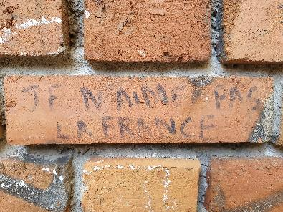
Barriers
Lack of trust
Structural problems
Extreme isolation
Difficulties asking for help
Don’t need
Grafitti, quartier des Rottes, Vendôme
Notes:
Woman living in a camp with husband and son, explained that she’d been in contact w/many associations, but didn’t trust them: « They don’t help », she said, People who live with me go to these associations and they bring back a little food; they take your information, but nobody comes to help you. Help getting your papers? No. I worked with a social assistant for 4 years and she didn’t do anything. »

Slide 96
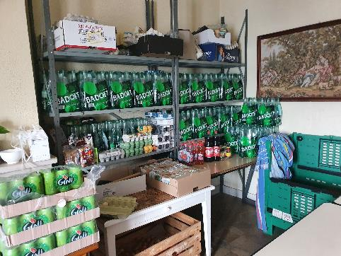
Barriers
Lack of trust
Structural problems
Extreme isolation
Difficulties asking for help
Don’t need
Food bank
Notes:
Another barrier is extreme isolation – not knowing what’s available, but can change over time.
But a lot of informants didn’t know what was available and had to find out through word of mouth: one asylum seeker told us that she spent an extended period of time living on the street until she was approached by another woman who gave her info about an association to contact: with that one contact, she was able to access an array of assistance.

Slide 97
Barriers
Lack of confidence
Structural problems
Extreme isolation
Difficulties asking for help
Don’t need
Opacity of bureaucratic procedures
Costly care, not covered by insurance
Vendôme: medical desert
  Retirements
  Lack of specialists or generalists
  Preference for alternative or paramedical care
  Lack of confidence in medical personnel
  Use of private clinics
  Transport problems (distances, public transport desert)
Waiting lists CMPs
Lack of housing (Paris region)
Closures
Notes:
53 year old man w/chronic illness in Vendôme region: « with a really serious illness, it’s a real medical desert here…the doctors, they don’t know anything, there aren’t specialists. »

Slide 98
Barriers
Loss of trust
Structural problems
Extreme isolation
Difficulties asking for help
Don’t need it
« I don’t have the right »
Pride
Fear
Notes:
Difficulties are several: Fear of being reported to officials (sans-papiers)
multiple times, we heard from informants (« I don’t have the right ») – my situation isn’t so bad, I come from a comfortable family, I’m not suffering so much, there are people worse off than I am.
Particularly striking among women coping w/domestic violence who realized that what they’d recognized as marital conflict was in fact domestic violence.

Slide 99
Conclusions
Institutional barriers to human agency
Barriers to accessing aid and assistance
Lack of trust
Notes:
Come back to this figure; clear that these themes are overlapping
One final, surprising commonality across sites: saw less solidarity in quartiers & villages (even in rural zone) than we expected; a few examples, but many people relied on family & friends if they had them. Paris region: v little solidarity, mutual aid within buildings, neighborhoods; Vendome: some farm-based exchanges but association activities stop →isolation

Slide 100
Conclusions: Potential policy recommendations
HEALTH IS ALSO MADE OR BROKEN OUTSIDE OF THE HEALTH SECTOR!
Housing:
  Make housing more available for those needing it in Paris region
  How to manage exodus from Paris to rural zones, driving up housing prices?
Invest in promoting inclusivity and revitalizing communities
  Social, cultural activities & economic investments to promote spatially-based (neighborhood, village) solidarities
Build bridges across socially isolated populations, using skills and experiences of individuals
  Elderly and students, asylum seekers, cultural workers
Promote existing aid/assistance structures
  What is available, where, for whom?
  Reduce doubts, fears, stigma around use, underscoring the distinctions between equity and equality
  Simplify procedures for access
Notes:
Structural issues: medical deserts; political changes for more funding for HCWs, Ehpads, assistance for asylum seekers and migrants ; transformation of empty housing for those who don’t have access

Slide 101
General Discussion
Notes:
Structural issues: medical deserts; political changes for more funding for HCWs, Ehpads, assistance for asylum seekers and migrants ; transformation of empty housing for those who don’t have access

